Slide 1
Fireball!
Game Art Bible

Slide 2
Overview
“Team up with or against your friends in the Baby Dragons’ Playgrounds as you Fireball critters for the highest score in this action-packed party game!”
Fireball! is a multiplayer party game where players control cute baby dragons trying to kill cute little critters. We are using a cutesy, simplistic, and colourful visual style in order to best relay the cute and playful concept, while also taking advantage of it for a humourous contrast with the violent gameplay.
To make the experience more dynamic and hectic, we will have various powerups and a constant stream of critters. At the end of rounds, we will further add to the humour with gag achievements.

Slide 3
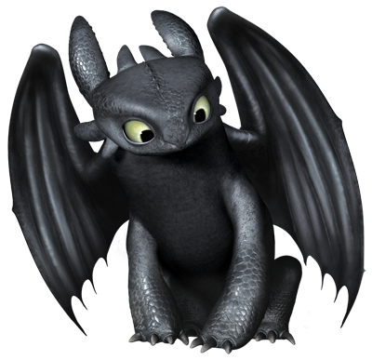
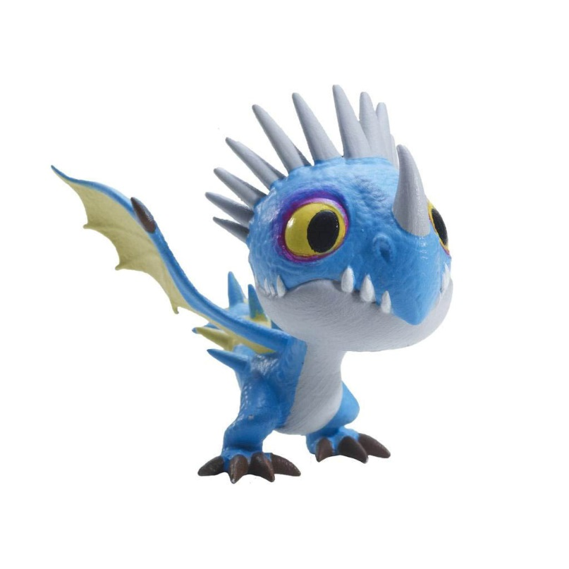
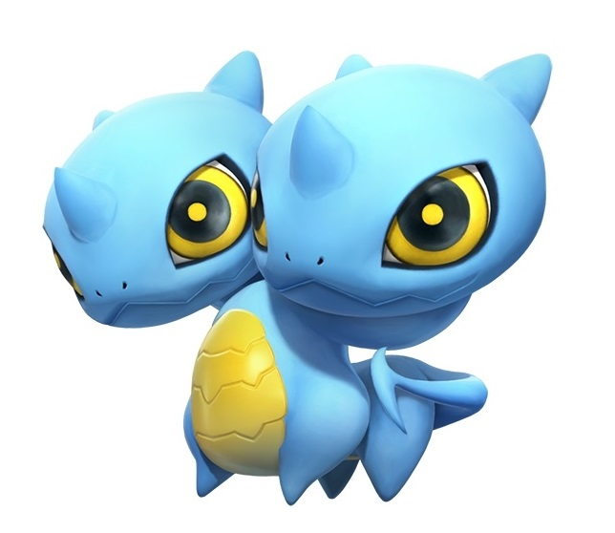
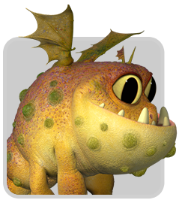
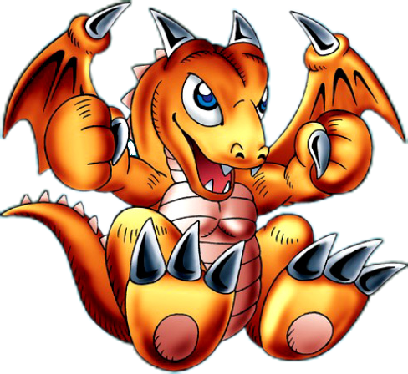
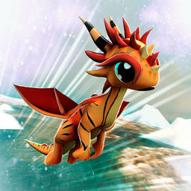
Character Style Guide
The idea behind the dragon designs is to have them be recognisably young as well as cute and cartoonish.

Slide 4
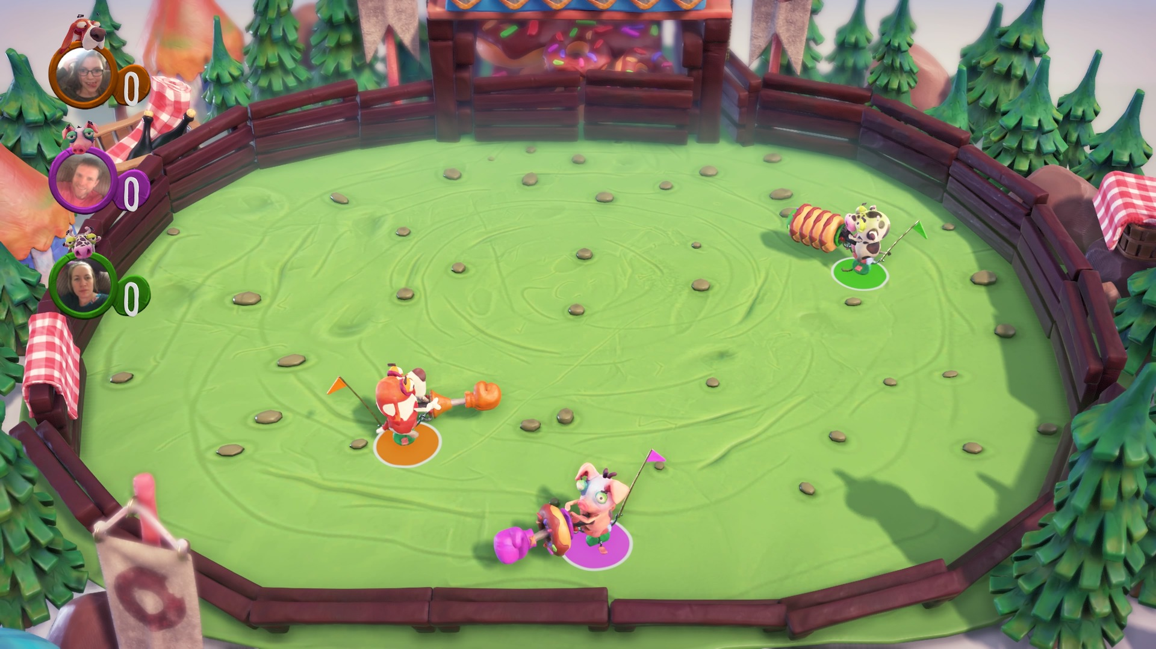
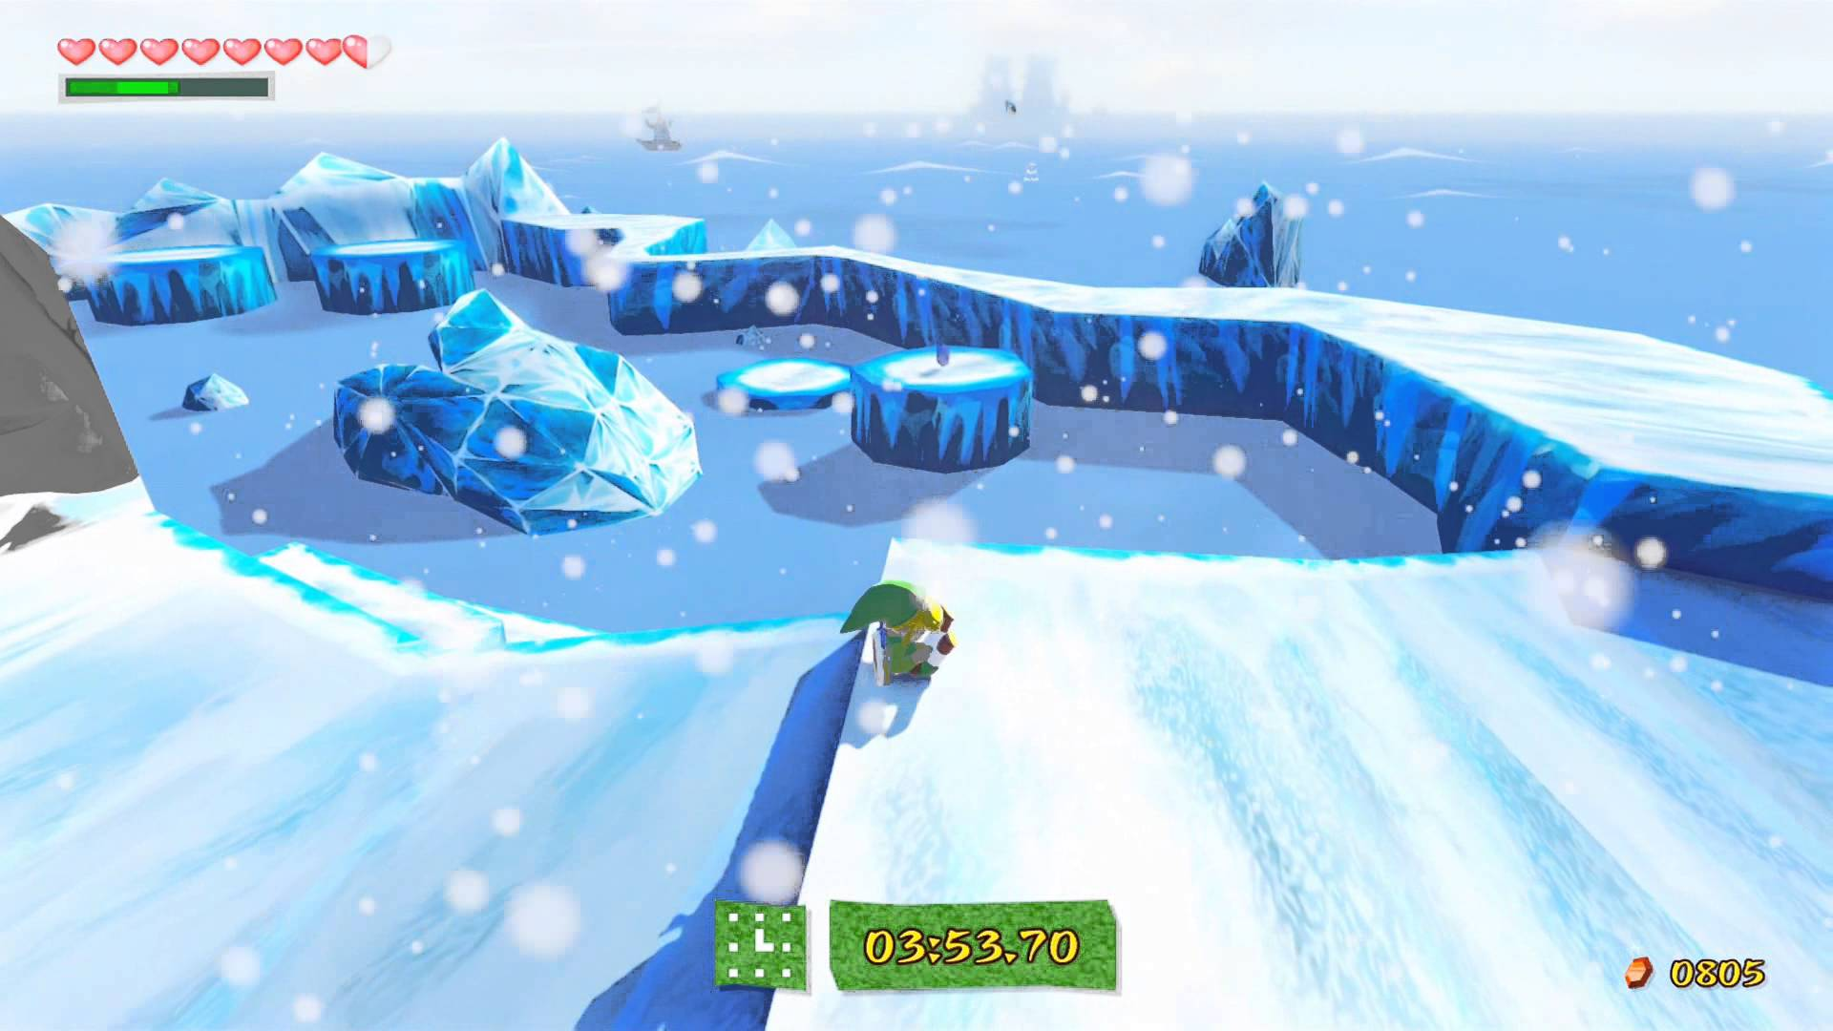
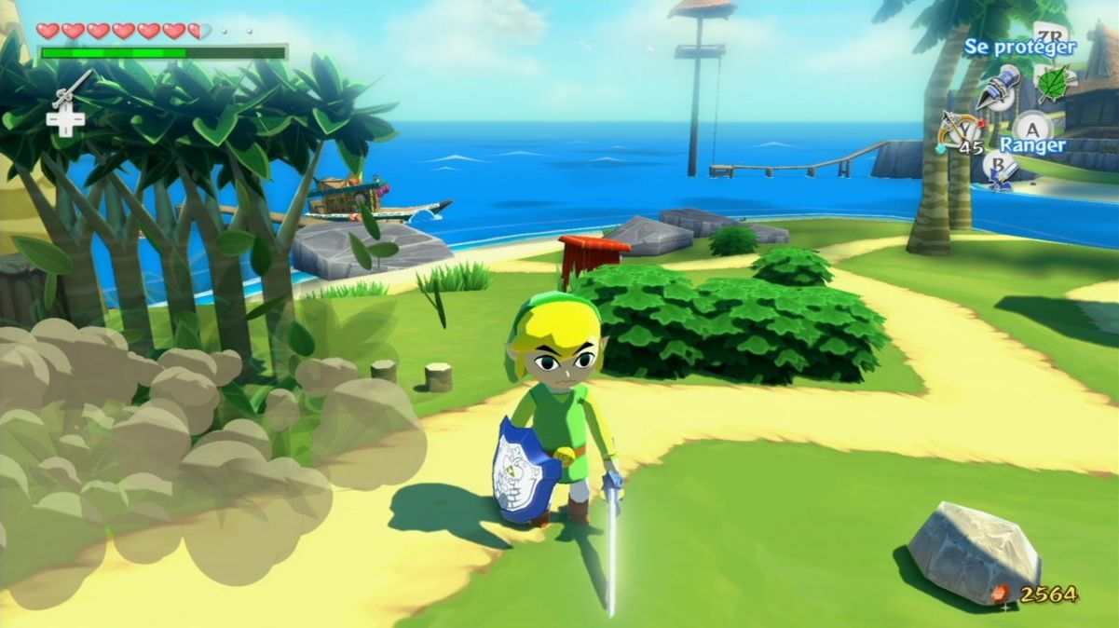
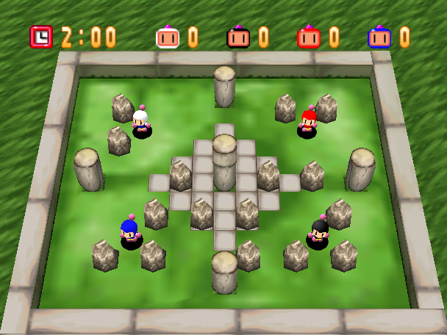
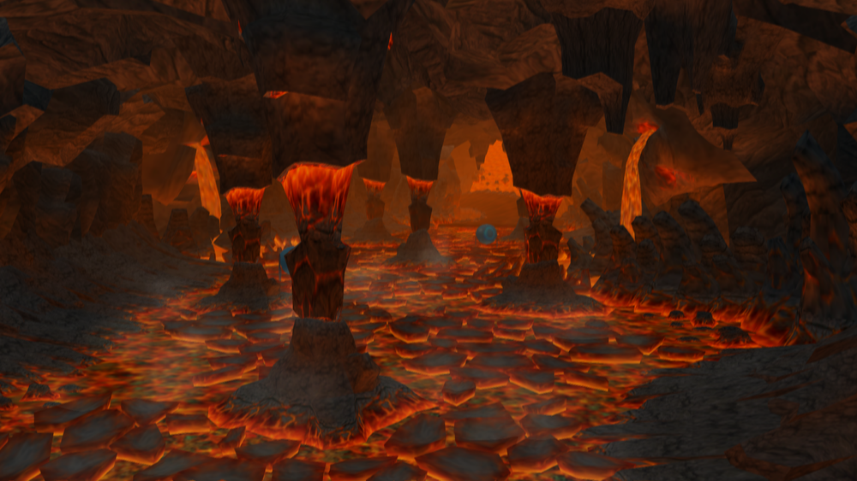
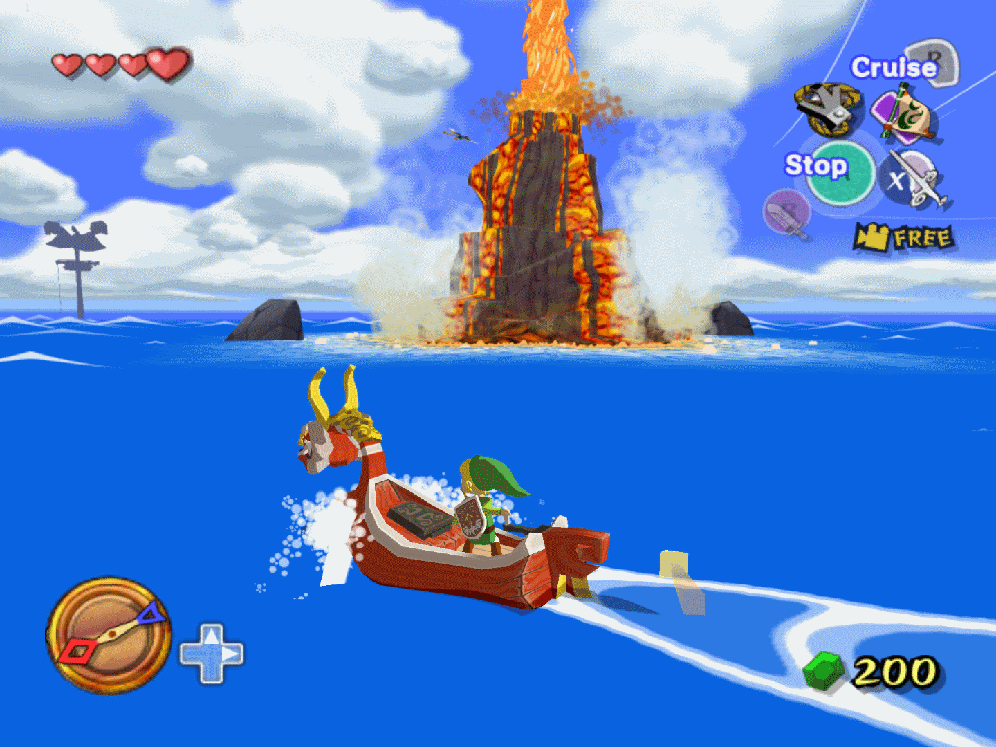
Environment Style Guide
The environments are cartoony and simplistic. Environment assets lean toward being more angular than perfectly smooth.

Slide 5
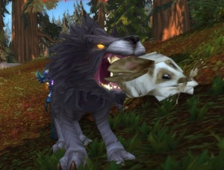
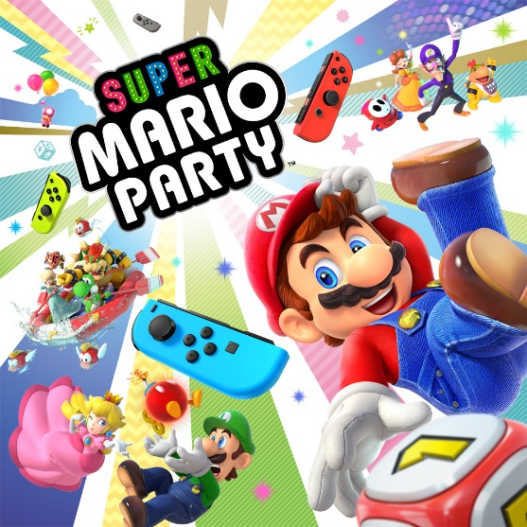
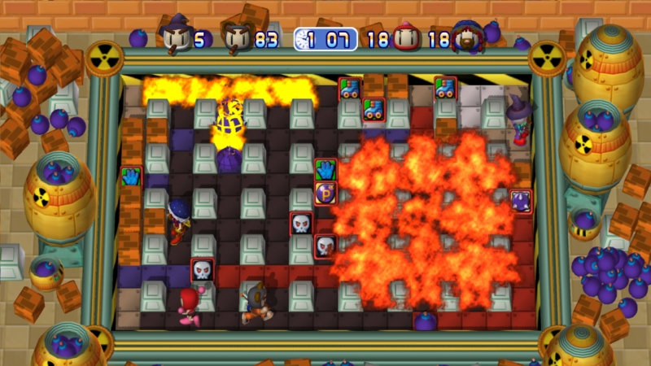
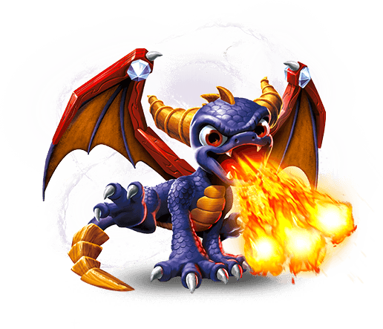
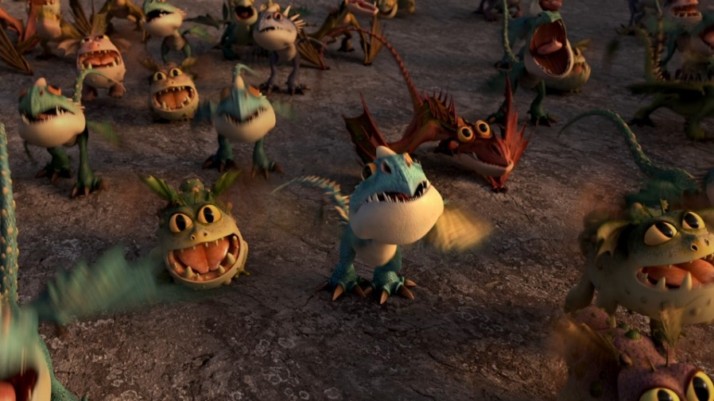
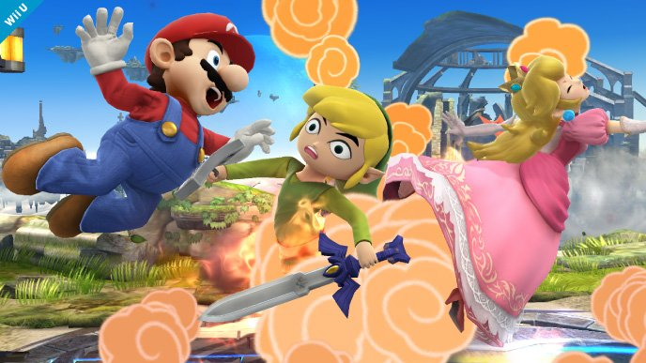
Game Moodboard
The game is colourful and ostensibly family-friendly, but also slightly morbid. It’s a hectic and violent experience while maintaining a cute exterior.

Slide 6
UI Designs
Stage Select
Fireball!
Start
Instructions
Options
Exit
Fireball!
Fireball!
Instructions
Options
-------------
-------------
-------------
Option
Option
Option
Option
Option
Start
Instructions
Options
Exit
Start
Instructions
Options
Exit
2/3
Simple, intuitive layout for easy navigation of menus.

Slide 7
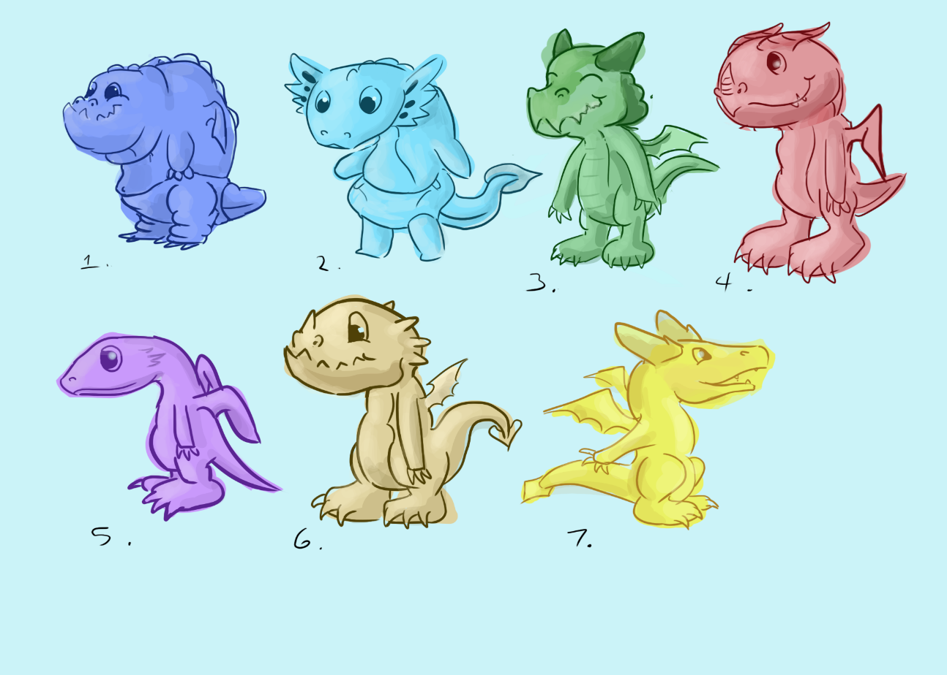
Character Thumbnails
We tested bipedal designs. Bipedal dragons would give more horizontal space to work with, but they seemed off and not “baby” enough.

Slide 8
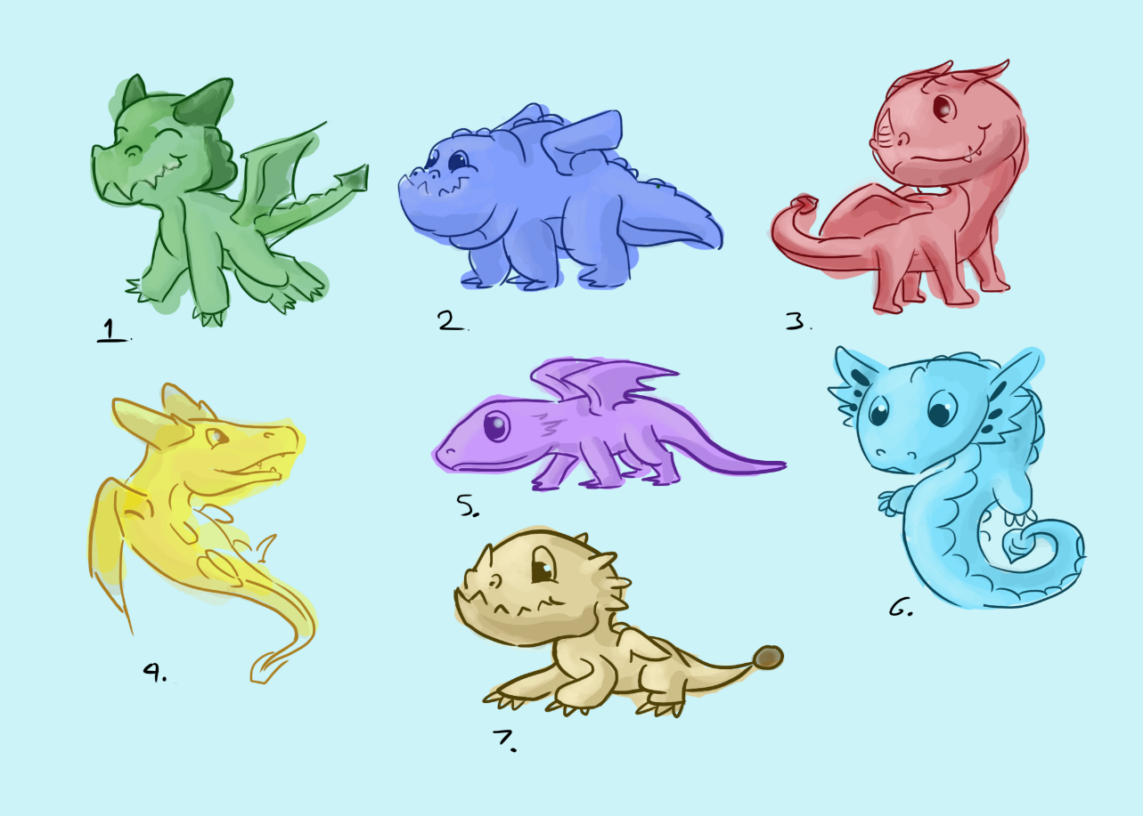
Character Thumbnails
The classic quadruped design looked more natural. It was also easier to make them look cute and more “baby” in this style.

Slide 9
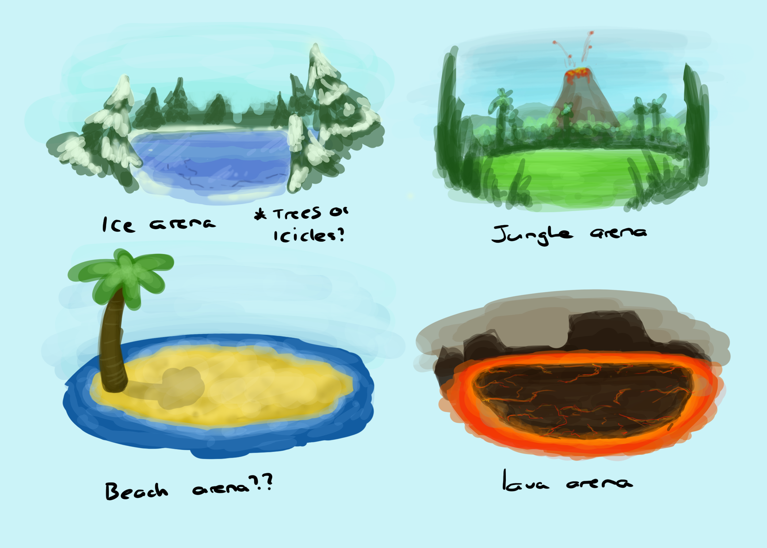
Environment Thumbnails
We are planning to eventually have multiple playable areas.

Slide 10
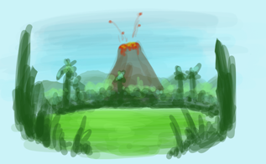
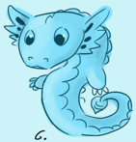
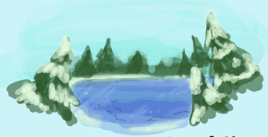
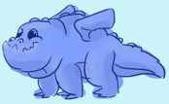
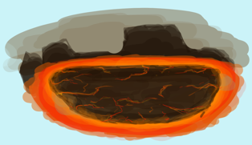
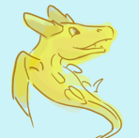
Colour Palette
Ice map colours.
Firey/Volcanic map colours.
Dragons could potentially go with these colour schemes as well.
Beach map colours.

Slide 11
Artists & Roles
Name:
Wing Him Choi
Roles:
Environment models, Environment Texturing, Rigging, Animation, UV unwrapping
Name:
Tiarna Kilmister
Roles:
Concept Art (Character), Concept Art (Environment), Character models, Character Texturing, UV unwrapping

Slide 12
Asset List
Wing Him Choi:
Item: | Description:
Tree 1 | Fir tree, main tree for the forest
Tree 2 | Curved tree with two main bunches of leaves
Tree 3 | Palm tree, usable in either a jungle or beach setting
Rock 1 - 6 | Various different rocks for variety, to be placed around the environment
Environment pieces | Different environment pieces themed after different settings for multiple maps.
Environement textures | PBR textures done in Substance Painter for the environment assets
Ground texture | PBR texture done in Substance Painter for the flat ground
Character Rigs | The rigs and skinning for all the characters, to be used for animation
Character Animation | Looping animations for the characters, to be used where appropriate in the game

Slide 13
Asset List
Tiarna Kilmister:
Item: | Description:
Dragon 1 | A quadruped, fat baby dragon. Playable character.
Dragons | Other dragons with different designs. Playable characters.
Bunny | Main destroyable critter for the forest map.
Critters | Other destroyable critters themed after the maps they would be in.
Concept Art | Concept art for characters and environments.
Dragon textures | Handpainted textures for the dragons. Four colour variations, one for each potential player.
Bunny texture | Handpainted texture for the bunny. At least two colour variations for visual variety.
Critter textures | Handpainted textures for the other critters.

Slide 14
Platform Considerations
Our game will be on PC. On higher end, this has very few limitations aside from lack of touchscreen functionality. On the lower end, we would need to worry about file sizes and poly count to be able to support older hardware and software.
Our art pipeline will be standard as we’re working with PC. No special requirements or methods.
2D Assets:
File Name | Art Type: | Texture Resolution:
FB_[assetName]_UI | UI | 256 x 256
FB_[assetName]_Texture | Texture | 256 x 256
FB_[assetName]_AnimTexture | Animated Texture | 256 x 256
3D Assets:
File Name | Art Type: | Poly Count Limit:
FB_[assetName]_Prop | Prop | 200 - 400
FB_[assetName]_Char | Character | 500 - 1k
FB_[assetName]_Env | Environment | 50 - 500

Slide 15

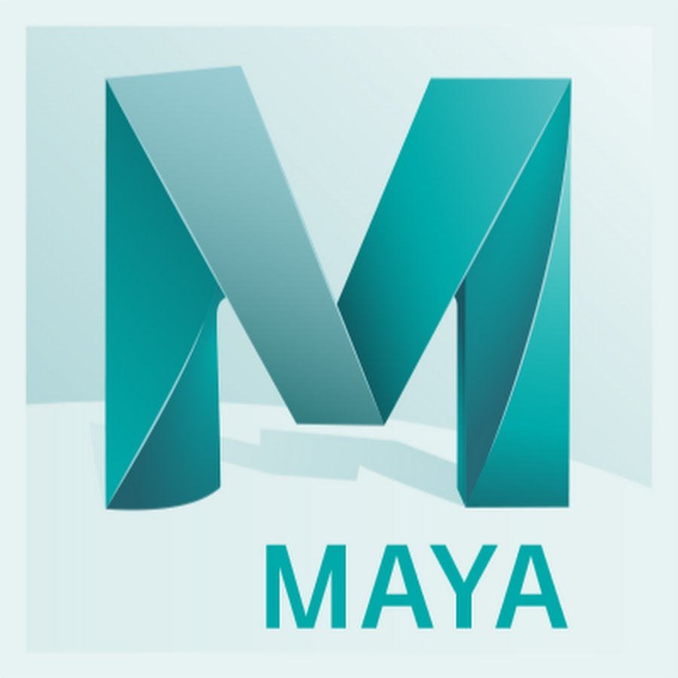

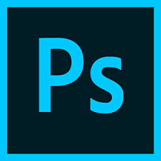
Software
Maya
ZBrush
Substance Painter
Photoshop
Maya is an industry standard software for modelling and animation. The artists are also trained in using it.
ZBrush is a commonly used a versatile sculpting software. The artists are also trained in its use.
Substanace Painter is a great piece of texturing software and works well with Maya. The artists have been trained on it.
Adobe Photoshop is also a good program for handpainted texturing and 2D drawing.

